Slide 1
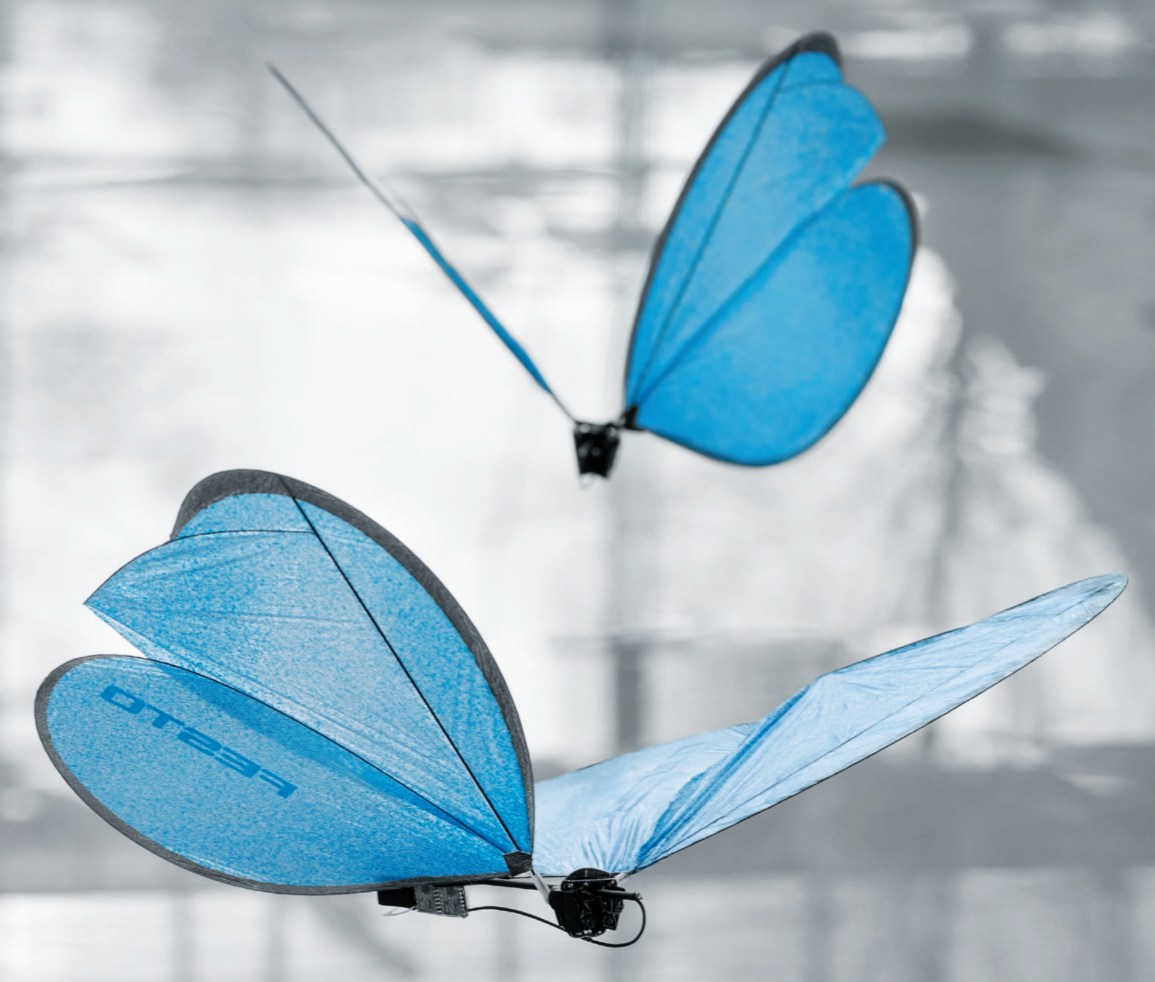
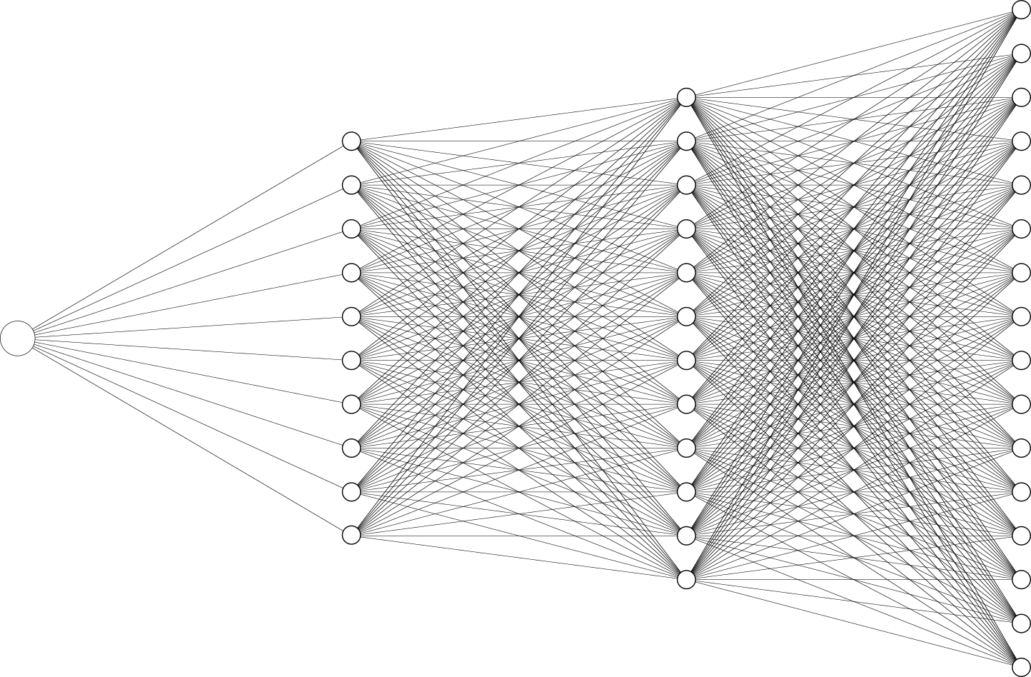

Robust Design of Bio-inspired Drones with Verified Neural Networks​
[1]
F21AR Masterclass – Colin Kessler
Supervisors: Prof. Ekaterina Komendantskaya, Prof. Ignazio Maria Viola
[2]

Slide 2
Contents
Introduction
Bioinspired Drones
Neural Networks & Verification
Research
Literature Review
Ongoing & Future Work
Conclusion

Slide 3
Section 1a
Bioinspired Drones
[1]
Notes:
So the practical applied area of research that I am interested in is the design and control of bioinspired drones. I am also looking into the more theoretical area of neural network verification, which I will cover later.
Bioinspired drones – as in flying robots inspired by nature (potentially is a loose manner), not necessarily trying to mimic every aspect (biomimicry)
In other words, I am interested in implementing technology based on biological principles, as oppose to strictly imitating biology

Slide 4
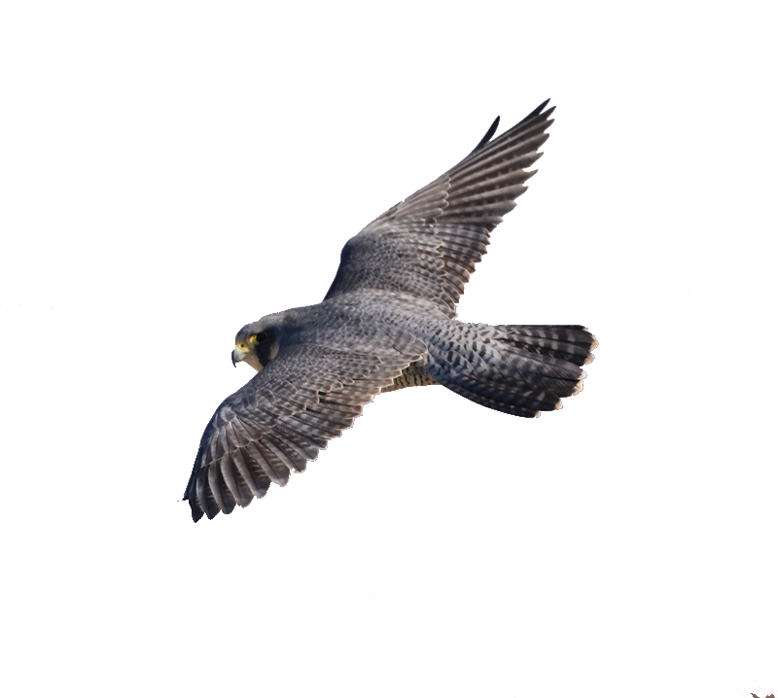
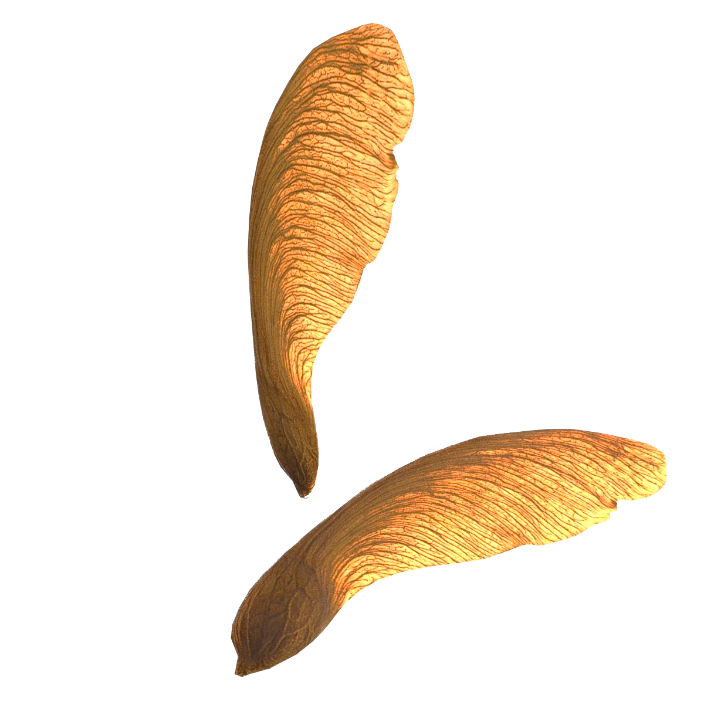
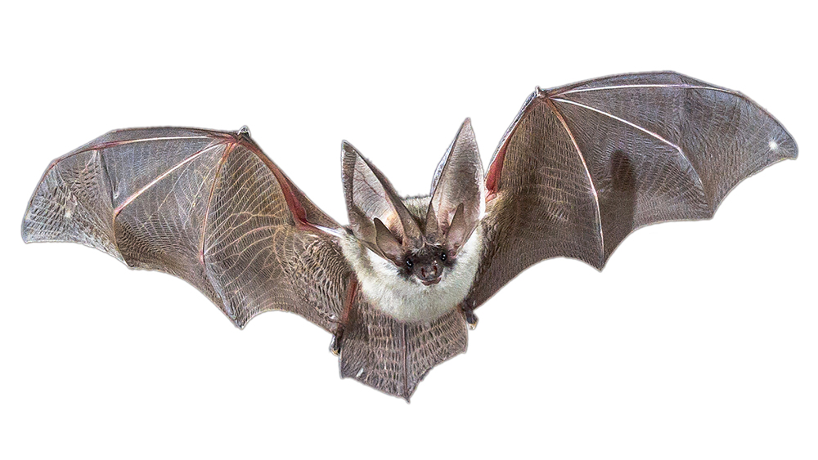
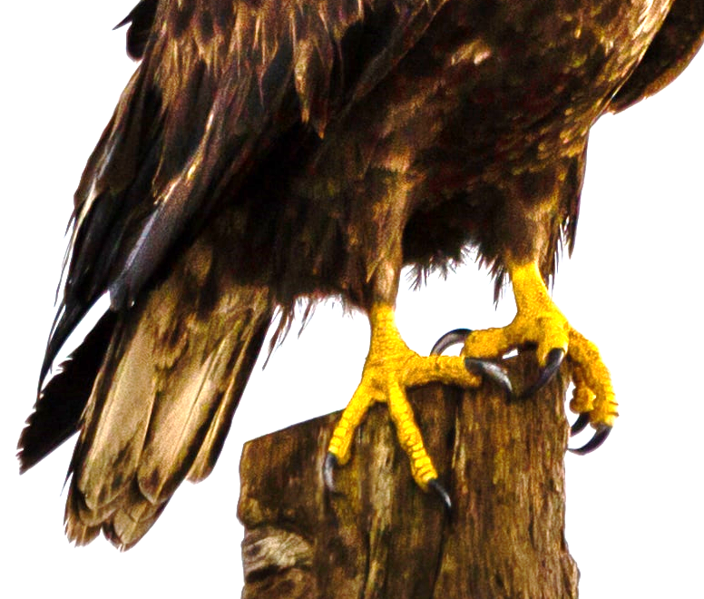
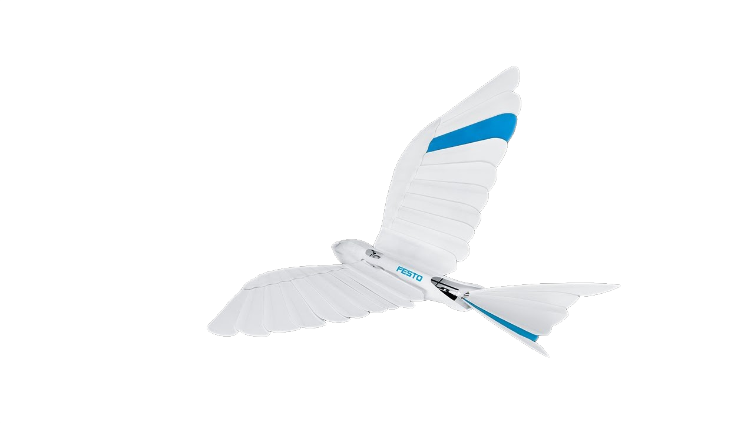
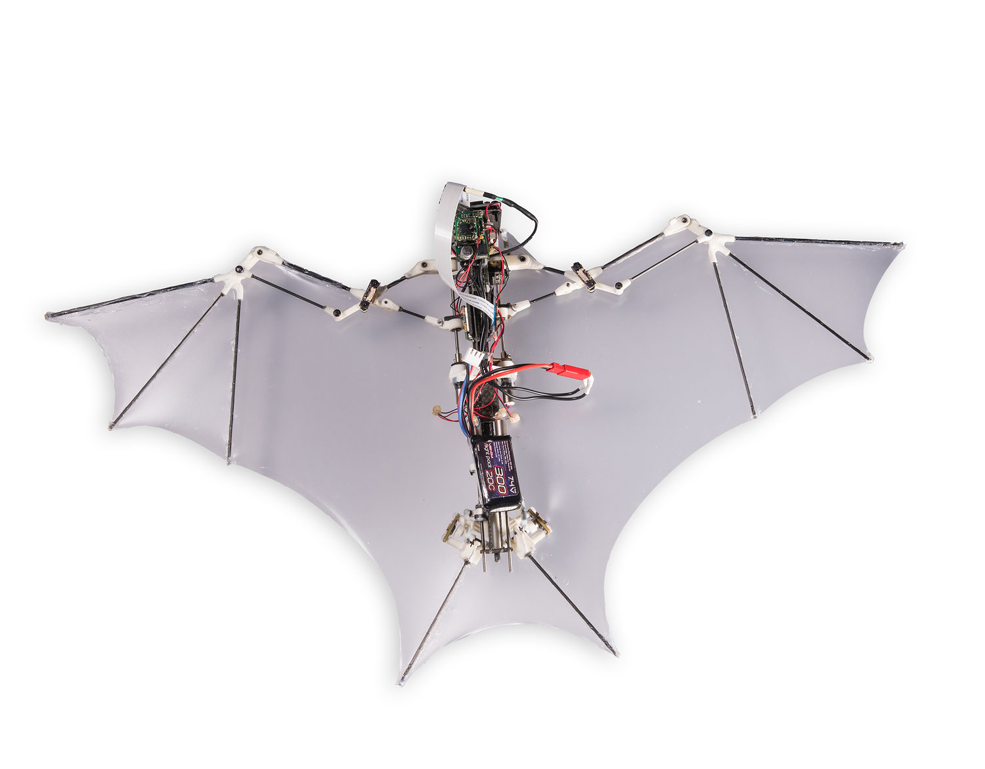
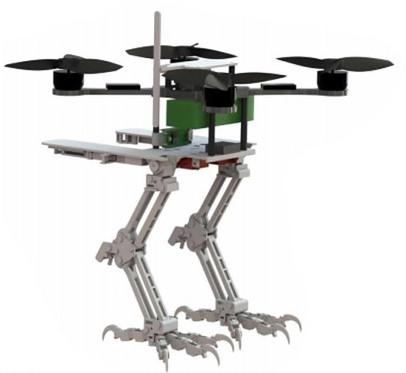
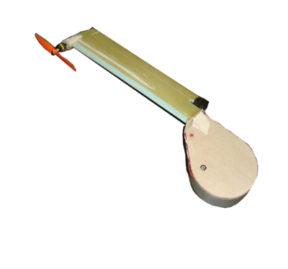
1a – What are Bioinspired Drones?
[11]
[3]
[4]
[5]
[6]
[7]
[8]
[9]
[10]
Notes:
Briefly introduce the concept of bioinspired flying robots (Ornithopters, Gliders), pose a thought-provoking question about their potential impact.
Provide more examples of bioinspired designs beyond ornithopters and gliders. Discuss their unique features and potential use cases.
Many different designs exist for bioinspired flying robots, many of which could be very useful.
For example, the bird-inspired BionicSwift has flapping feathered wings, and is capable of
The Bat Bot B2, inspired by bats, has wings capable of morphing for efficiency and stability in flight
The SNAG, a biomimetic robot capable of perching on complex surfaces, which could be useful for studying ecosystems since it saves energy when in a perched position
The Samarai MAV is shaped like a maple seed, and is capable of controlled flight with only one motor
For my research so far, I am focusing on bird-inspired ornithopters and seed-inspired gliders

Slide 5
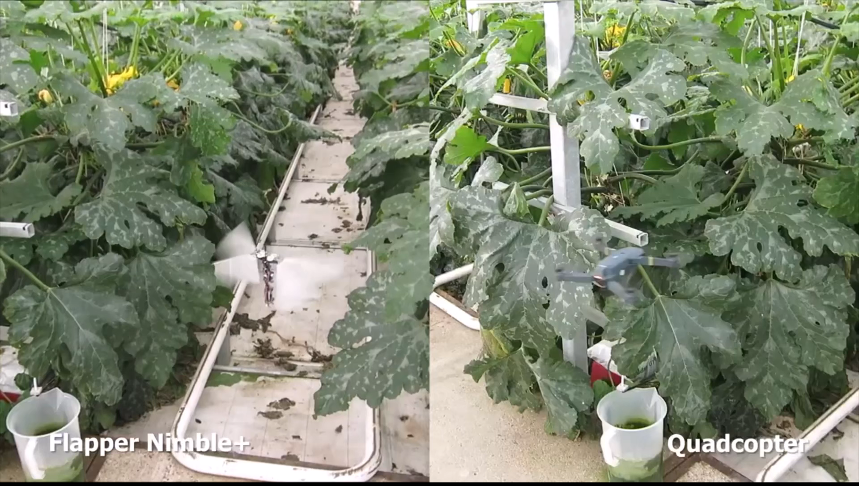
1a – Bird-inspired Ornithopters
When compared to quadcopters [12,13]:
Similar manoeuvrability*
Better flight efficiency*
Less noise
Safer in collisions
* requires complex control
[8]
[13]
Notes:
Dive deeper into the advantages of ornithopters over quadcopters. Provide specific examples or case studies that illustrate their efficiency, safety, and reduced noise.
Bird-inspired ornithopters offer advantages over traditional drone designs, since they can perform similar functions to both fixed-wing and quadcopter designs.
When compared to quadcopters: they can offer good manoeuvrability and better flight efficiency with fewer actuation mechanisms, due to the complex wing shapes found in nature after many years of evolution
Since they do not use blades for propulsion, they make less noise and are safer in the event of a collision
For example, the hummingbird-inspired Flapper drone can be seen here flying in a greenhouse environment with lots of obstacles compared to a quadcopter, and is able to maintain flight after a collision without

Slide 6
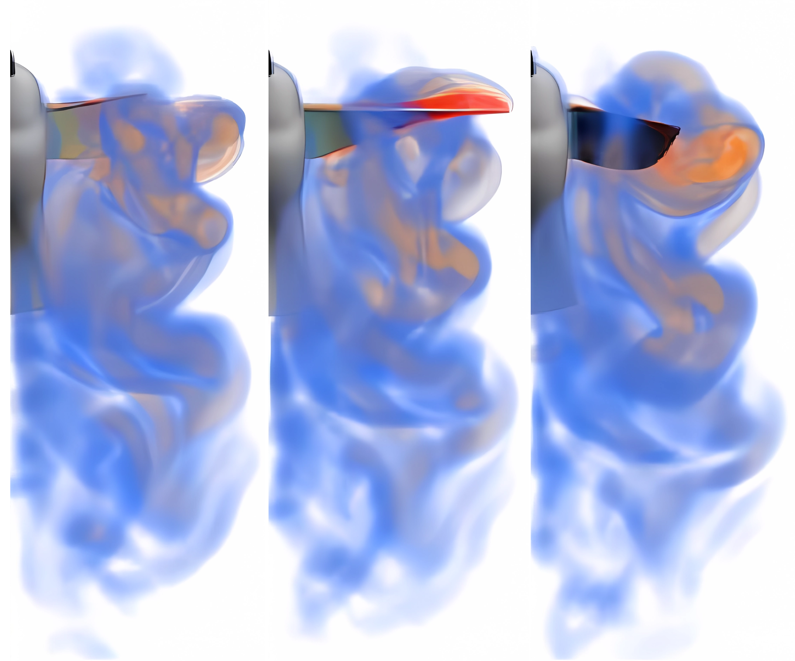
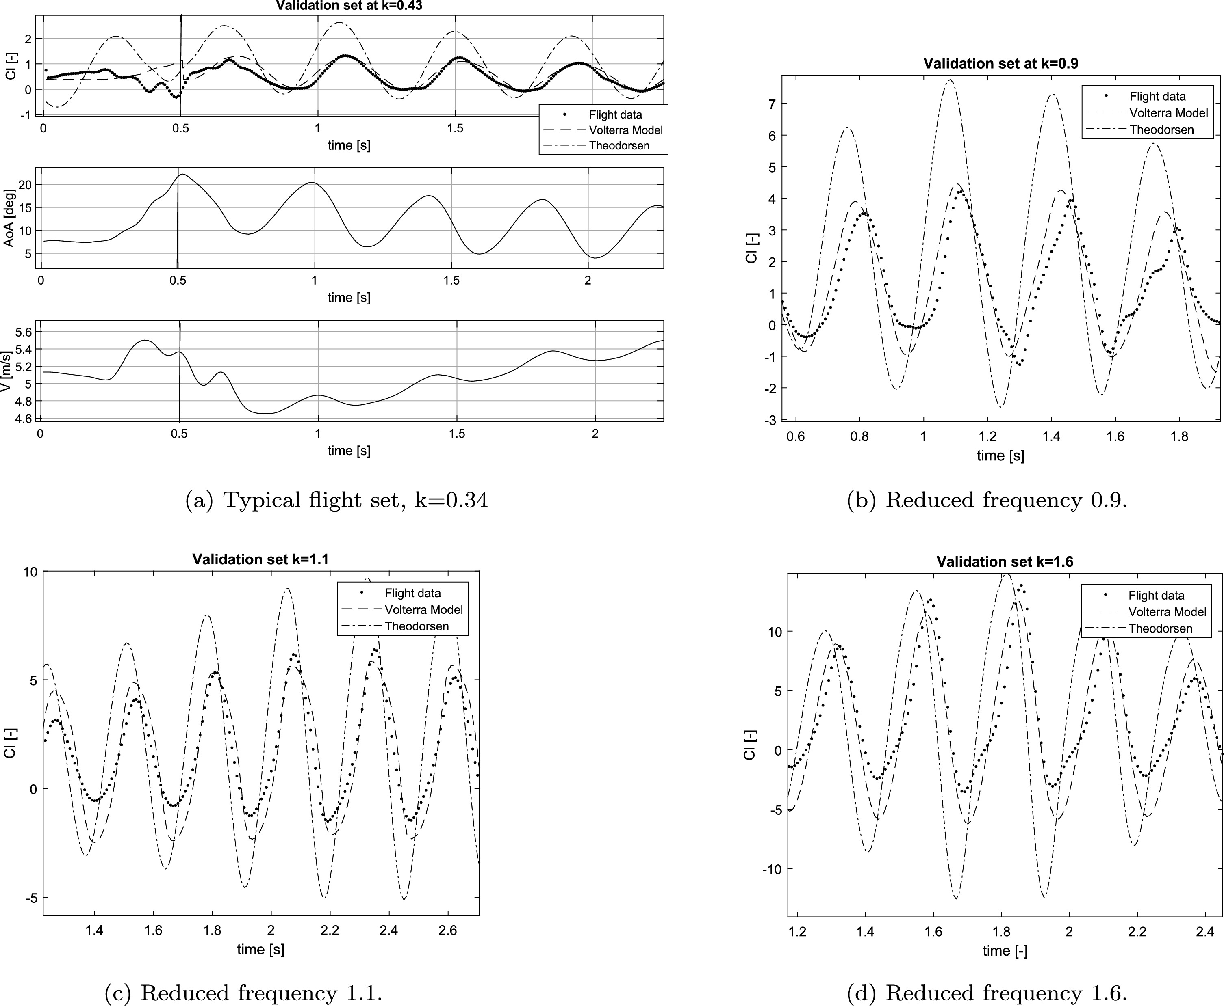
1a – Ornithopter Control
Dynamic behaviour (kinematics, airflow) needs to be predictable
Unsteady separating airflow is not fully understood [15]
Simpler designs have less control authority [16]
[14]
[15]
Notes:
Elaborate on the challenges faced in controlling these bioinspired flyers. Discuss specific issues related to aerodynamics and dimensions.:
Controlling bioinspired flyers is difficult the aerodynamics need to be understood well for effective control. ​
Efforts have been made to simulate the unsteady flow behaviour of birdlike wings during flight, but results have not been fully validated and a comprehensive theory has not yet been proven
This remains an ongoing area of research – for example in 2017 paper investigated a low-order model for flapping dynamics compared to high-fidelity simulation and experiment results, and found the model predicted general behaviour but with low accuracy due to many assumptions and uncertainties
Control methods for simpler 1-DOF insectlike flyers have been proposed that explicitly deal with parametric uncertainties, but are only proven in simulation

Slide 7
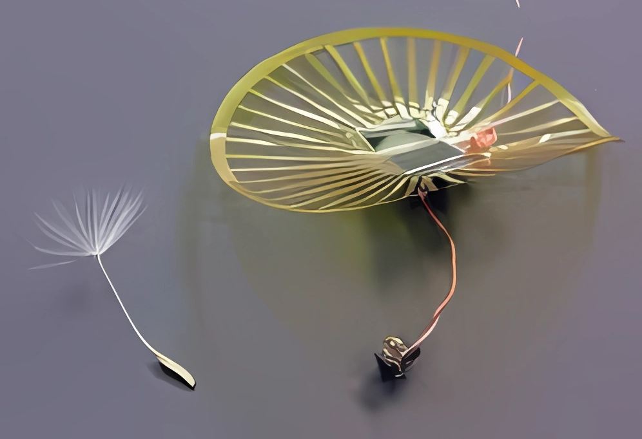
1a – Seed-Inspired Flyers
Based on anemochory – dispersal by wind
Seeds can flutter (maple), or float (dandelion)
Potential uses in surveillance and environmental monitoring
[6]
[10]
[17]
Notes:
Explore real-world scenarios where swarms of gliders could be deployed for atmospheric monitoring. Discuss potential environmental benefits and data applications in more detail.
Seed-inspired gliders are a different type of bio-inspired drone (based on gliding seeds), such as the previously mentioned Samarai MAV drone based on the maple seed, and dandelion seed inspired designs
In the case of the Samarai MAV, the designers intended to make use of the seed’s aerodynamics for controlled flight with a single actuator and 360-degree scanning for onboard sensors for surveillance applications
Dandelion seed-inspired robots such as the University of Edinburgh led DANDIDRONE project aim to make use of the seeds ability to remain airborne for days and travel hundreds of kilometers by the wind
Swarms of gliders could be used as sensor networks to monitor the atmosphere over long periods of time, providing data on the impact of natural disasters and human activities.
In the case of dandelion seed-inspired drones, control methods have not been comprehensively developed, although the challenges in control design are different when compared to ornithopter control.

Slide 8
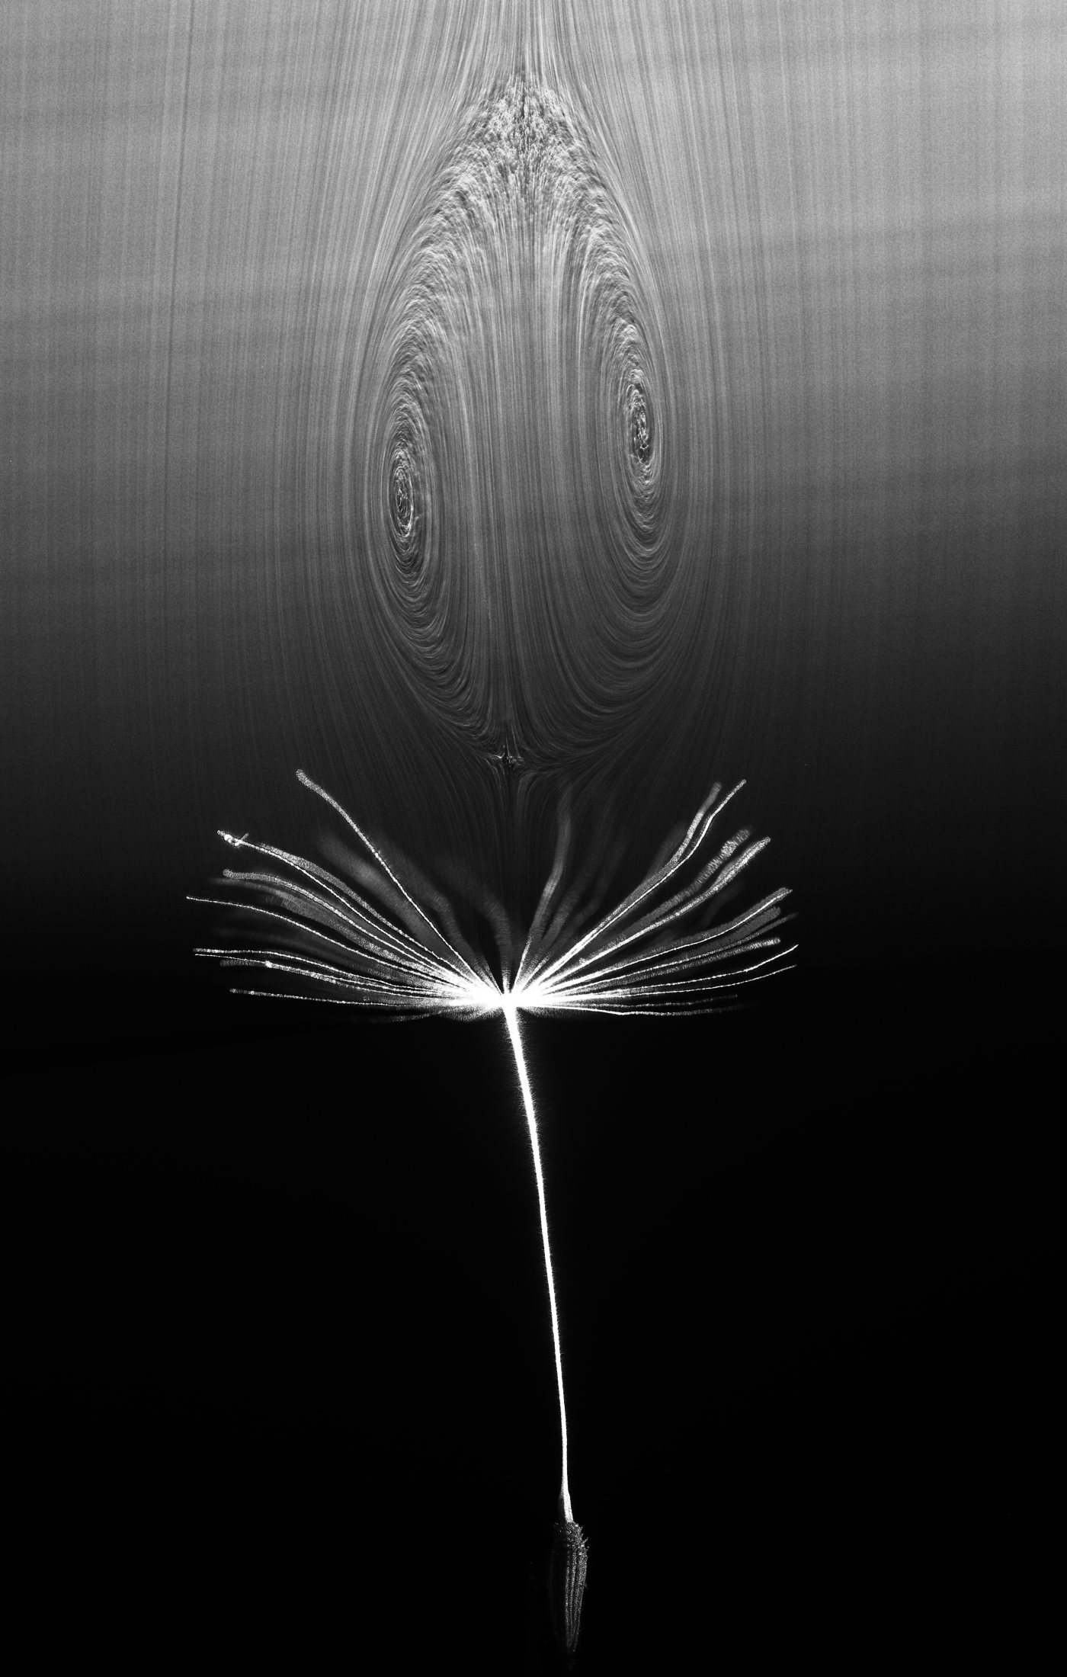
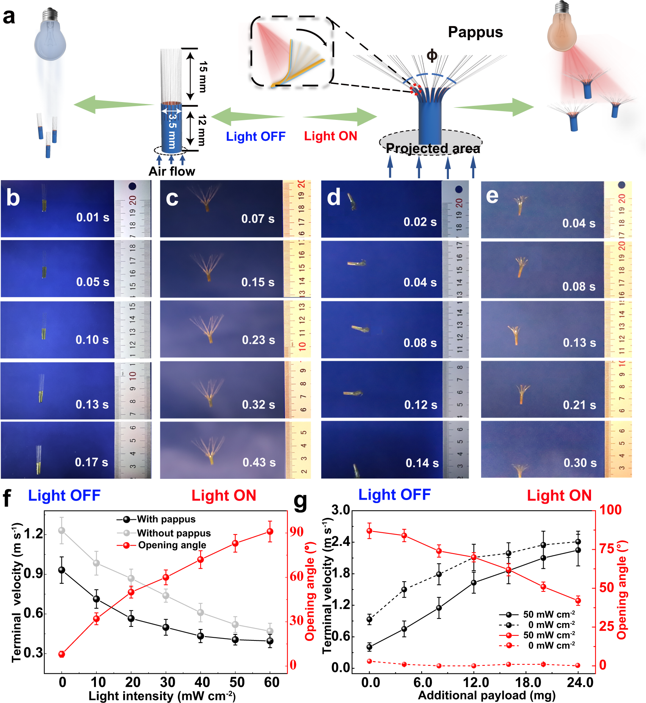
1a – Dandelion Seed-Inspired Flyer Control
UoE led DANDIDRONE project [18]
Dynamics are relatively simple (separated vortex ring) [19]
Actuation (shape morphing to alter falling speed) has been tested [20]
Comprehensive control not yet developed
[18]
[20]
Notes:
Address the current limitations in control methods for gliders, emphasizing the need for comprehensive solutions.
The aerodynamics of seed-inspired gliders are fairly well understood after recent research unveiled the existence of a stable separated vortex ring above the dandelion seed ring, allowing it to float in the wind at low speed
Furthermore, dandelion seeds can alter their shape to change their aerodynamic behaviour – the central pappus of the seed can morph to fall faster or more slowly – based on external factors such as humidity and temperature.
Actuation methods have been tested in experiments​ - in a simple case where a drone morphed in reaction to an external light source – it can be seen here falling at different rates depending on the actuation
Control methods have not yet been developed – the main challenge for this type of drone are the size, weight and power restraints – they need to be very small and lightweight. Control commands need to be based on a measured system variable, but how exactly this could work be has not been figured out
(NNs) could provide a potential solution to the control design, since they can be designed for limited processing power and trained to enable the robot to fly as long as possible

Slide 9
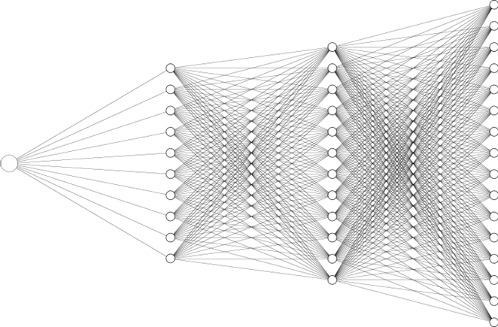
Section 1b
[2]
Neural Network (NN) Verification
Notes:
That concludes the applied area of my research, now onto the more theoretical side – neural network verification
To clarify – when I talk about neural networks, I am concerned about computer systems based on a network of interconnected nodes to fulfil a specific purpose, and rely on training datasets to have good accuracy.
There will be some machine learning aspect since a neural network requires it to function, but I am specifically interested in the neural network implementation into control systems for bioinspired drones, and subsequent verification

Slide 10
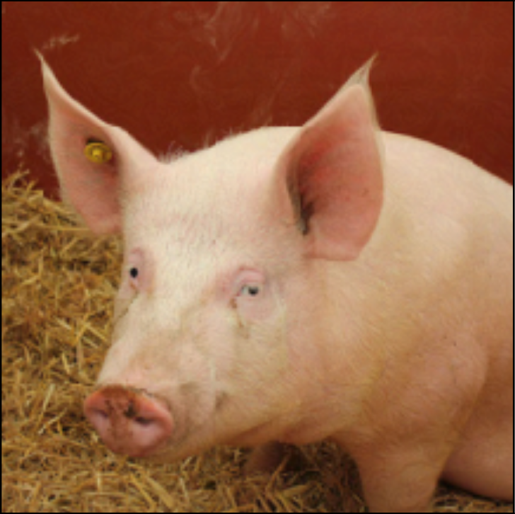
1b – NN Verification
NNs need to be verified to guarantee safety and robustness​
NNs typically have poor generalisation
Adversarial robustness is often poor (resistance to small perturbations):
+ perturbation =
NN Input
NN Output
“Pig”
“Wombat”
[21]
Notes:
Introduce NNV & Robustness
​
In short, NNV aims to guarantee that a system will respond appropriately given parameter errors and uncertainties. The neural network (and whatever system it is embedded in needs to behave with expectations for any possible inputs, to guarantee its behaviour when dealing with real world data
Generally, neural networks often display unexpected behaviour - such as adversarial robustness, which involves small perturbations.
For example – imagine an image recognition neural network trained to classify different animals. When presented this image, it correctly identifies it as a pig.
However – it is possible to perturb the image slightly in a particular way th
where a small change in the input drastically changes the output​
​

Slide 11


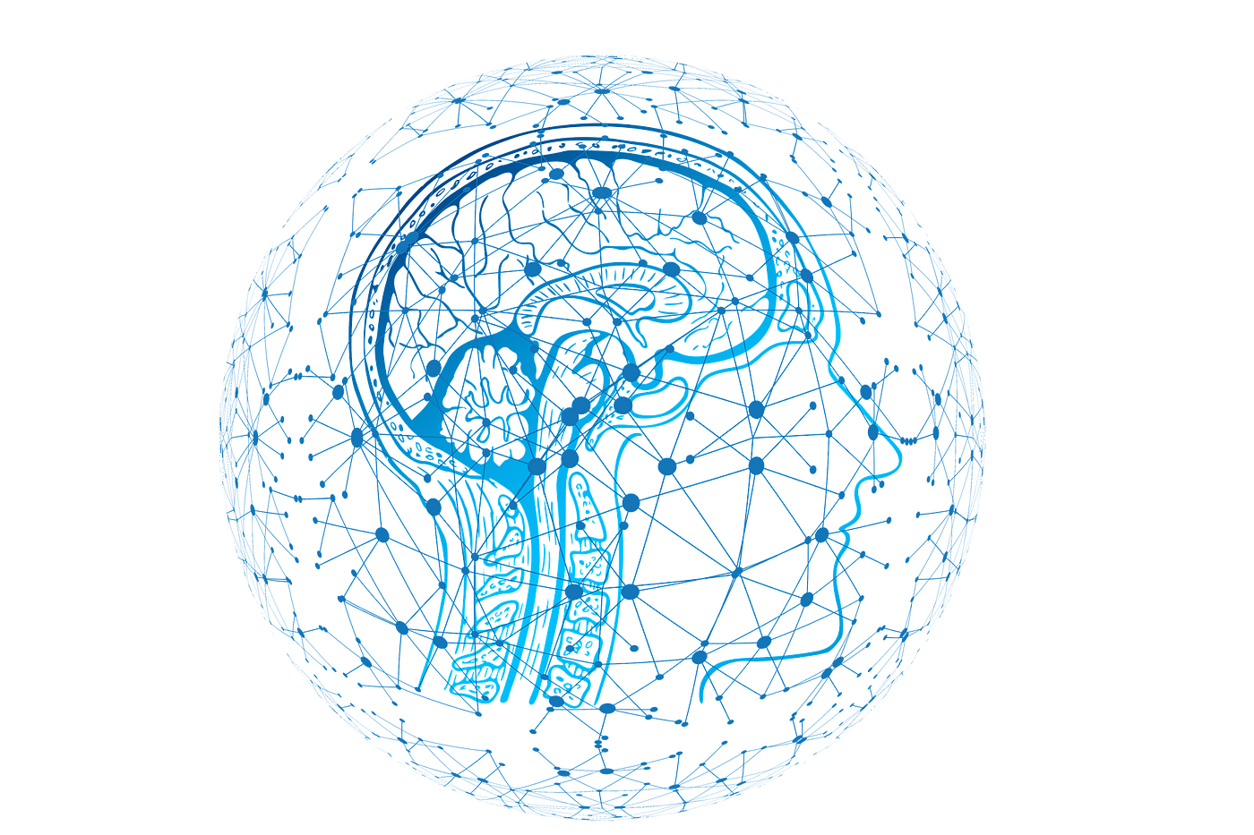
1b – NN Verification Tools
Open-source toolkits (Vehicle, αβ-crown)
Aim to make NN verification more accessible
Open-access competitions for tools and benchmarks (VNN-comp)
Development follows research
[22]
[23]
[24]
Notes:
Explore in more detail the existing benchmarks and verification toolkits, providing practical examples of their application.
Research into NN verification has produced standardised benchmarks and verification toolkits such as Vehicle [4].
In previous works, toolkits have been used to verify basic properties (prove safety-critical relationships between NN inputs and outputs [5]), re-train NNs to be more robust, and verify systems containing NNs [4].
Additionally, there is a yearly open-access competition which aims to compare toolkits across standardised benchmarks, and guide researchers in the field towards common goals
Since this is a relatively new area of research, toolkits often lack functionality required for real-world applications – development is guided by research efforts, which can take long periods of time

Slide 12
1b – NNs for Control
NNs can be used for control in different ways:
Different implementations create unique implementation/verification challenges
MPC
Reference
Control Commands
Reference
Optimizer
Control Commands
Neural Network
Neural Network Model
Sensor Data
Sensor Data
Notes:
Delve into the role of neural networks in controlling bioinspired drones.
For bioinspired drones, a NN could be used as a control system, or to improve a traditional control scheme such as MPC​
This requires deciding which method would be appropriate for a given system – for example, if modelling a flapping wing robot is too difficult (due to complex aerodynamics), then direct control may be more appropriate
On the other hand, control of a dandelion-inspired drone would require solving different challenges. ​
The problem is different since the aerodynamics are simpler (passive gliding vs flapping wings), but actuation/sensing options are limited and the behaviour of many robots in a swarm is of high importance​
In either case, the verification of the neural network is different – are we concerned about how the accurate the network models our system, or how it controls it?
A NN used for control would need to be verified to ensure it behaves as expected, whereas a NN used for simulation would need to be verified to ensure it correctly predicts the system dynamics ​
Applying this to a flapping wing drone would require an understanding of system behaviour in simulation or experiments before the NN can be verified or even trained​

Slide 13
Section 2a
Literature Review

Slide 14
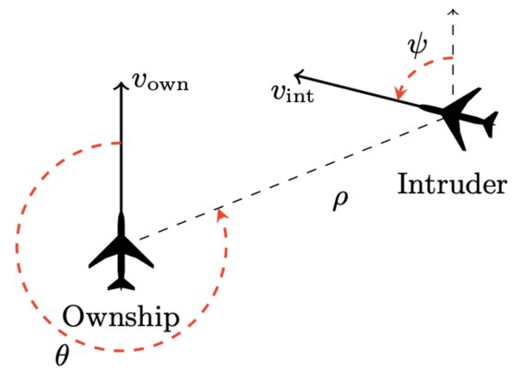
2a – Applying NNV to Control – Aircraft Collision avoidance
[25,26]
Inputs are system variables, outputs are commands​ (such as COC – clear of conflict)
​
​
​
​Verification property: If the intruder is directly ahead and is moving towards the ownship, the score for COC will not be minimal
Notes:
How can NNV be applied to control – control side

Slide 15
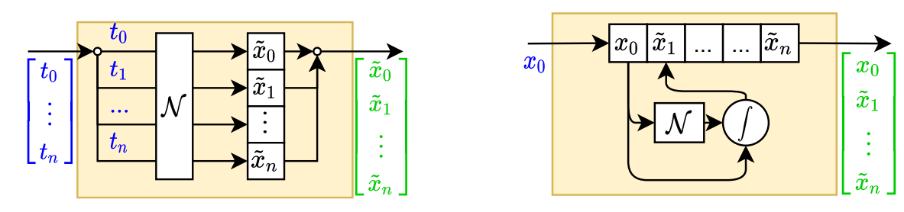
2a – Applying NNV to Dynamical simulations
[27]
2 categories of Dynamical Simulation NN:
Direct Solution - Predicts parameters over time, given initial conditions
Time Stepper - Iteratively predicts derivatives, integrated into solution
Notes:
Direct Solution: Predicts parameters over time, given initial conditions [1, p8-14]​
Limited to one set of initial conditions, no time-dependant inputs​
Can incorporate physics constraints (physics-informed NN)​
​
Time Stepper: Iteratively predicts derivatives, integrated into solution [1, p14-27]​
Can be trained for multiple trajectories, and time-dependant inputs​
Requires numerical integration scheme​
More considerations (external inputs, error accumulation)
Choosing 1 vs the other depends on what modelling method is required (initial value or ongoing constraints)

Slide 16
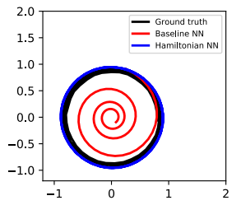
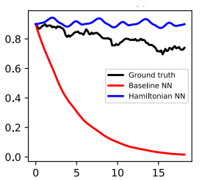
2a – Applying NNV to Dynamical simulations
[27,28]
Energy conservation can be enforced to maintain accuracy (Hamiltonian, Lagrangian, or potential energy NNs)
Pendulum example:
Noise and uncertainty can be dealt with using different methods (Markov, Bayesian NNs)1
Position over time:
Energy over time:
[28]
Notes:
Self-driving car example

Slide 17
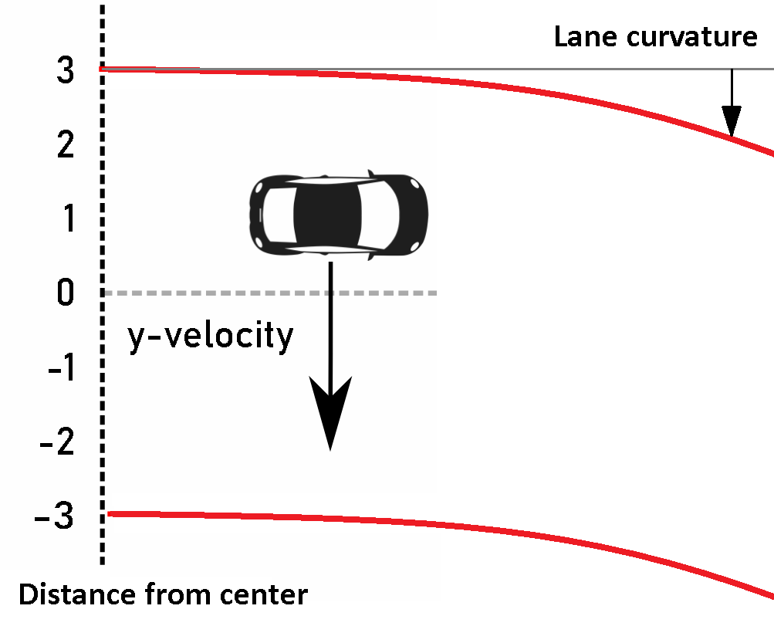
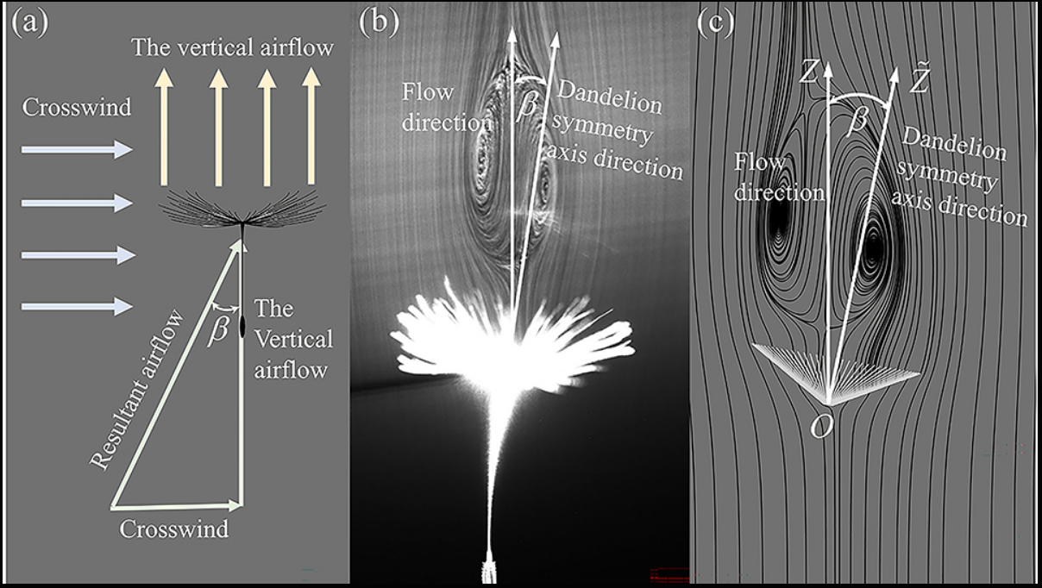
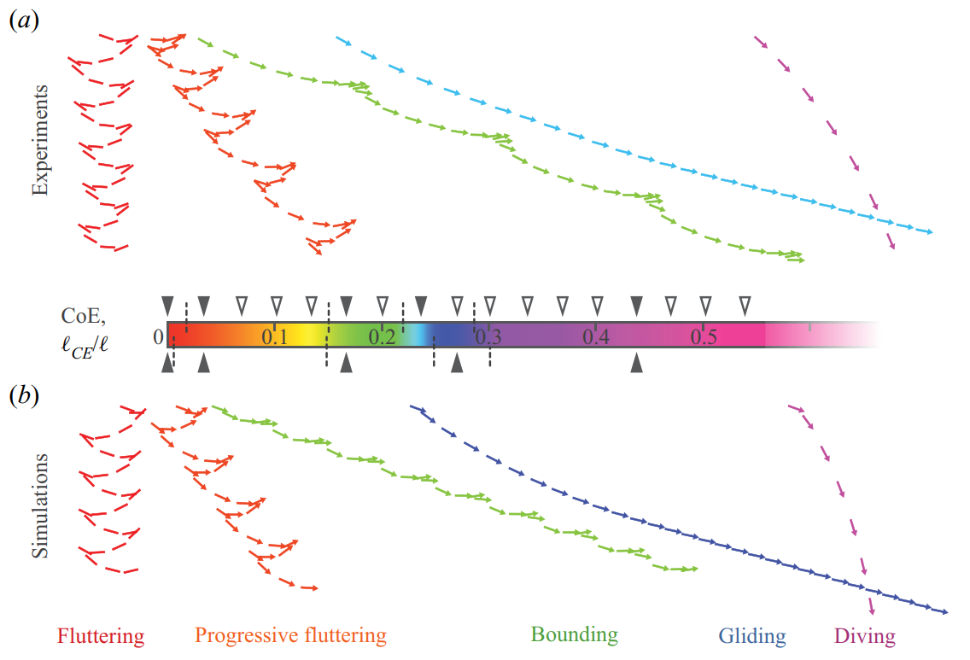
Section 2b
[25]
[29]
Ongoing and Future Work
[30]

Slide 18
2b – NNV for Control (Self-driving Car)
NNs controlling cars need robustness and safety guarantees
Dynamics are (relatively) simple
Different NN implementations:
Nvidia CNN [31]
F1tenth [32]
[25]

Slide 19
2b – NNV for Control (Dandelion Drone)
[18,29]
Approach 1: CFD
Areas to explore:
Use NNV to better understand dynamics
Couple NN with CFD for control simulation
Issues:
CFD requires significant expertise
NN coupling may be difficult
[29]
Notes:
Objective: predict drone dynamics given turbulent perturbations (2D)
Once an NN that predicts the drone dynamics is trained:​
Maximise desired output using gradient method, or NN verification​
Verify result with CFD​
Improve robustness with verification analysis​
Can the relationship between inputs/outputs be approximated otherwise?​
​
Next steps​
Learn OpenFOAM, generate training datasets​
Train/test/verify different NN approaches

Slide 20
2b – NNV for Control (Dandelion Drone)
[18,30]
Approach 2: Low-order simulations
Areas to explore:
Optimising model for drone
Attempt control methods
Compared to CFD approach:
Less expertise required
Focus more on control
Possibly less accurate
[30]
Notes:
Provide a comprehensive overview of how neural network verification can be applied to enhance the control of dandelion-inspired drones.
Discuss the potential impact on performance and safety.

Slide 21
Section 3
Conclusion
[1]

Slide 22
3 - Objectives
Research NN verification literature and toolkits​
How can NNs be implemented into control systems:​
for bioinspired flying robots?​
for mobile robots in general?​
What verification properties are important?​ What can or should be verifiable?
Notes:
Elaborate on the challenges faced in controlling these bioinspired flyers. Discuss specific issues related to aerodynamics and dimensions.

Slide 23
3 – Closing Statement
Bioinspired drones could have many applications
Safety and robustness of control are critical – and difficult to achieve for complex tasks
Neural Network Verification could facilitate better, safer technology implementations
Notes:
Elaborate on the challenges faced in controlling these bioinspired flyers. Discuss specific issues related to aerodynamics and dimensions.

Slide 24
References 1
Festo Ltd. eMotionButterflies (2023) www.festo.com/gb/en/e/about-festo/research-and-development/bionic-learning-network/highlights-from-2015-to-2017/emotionbutterflies-id_33454/​
AlexNail.me. NN-SVG (2023) alexlenail.me/NN-SVG/
Union County Falcon Camera. Education (2023) ucnj.org/falcon-camera/education/
F Sherwin. How Did the Bat Get Its Wings? (2022) www.icr.org/article/how-bat-get-its-wings
P Nuij. brown and white eagle on brown tree branch during daytime (2020) unsplash.com/photos/brown-and-white-eagle-on-brown-tree-branch-during-daytime-MybAB_akyF8
CGZarvandi. 3D Maple Seed (2023) www.turbosquid.com/3d-models/3d-maple-seed-1404033
A Malewar. BionicSwift, an ultralight bionic bird from Festo that flies like real birds (2020) www.inceptivemind.com/festo-bionicswift-bionic-bird-artificial-feather/14179/​
L Oliwenstein, R Perkins. Bots on the Move (2017) magazine.caltech.edu/post/bots-on-move
University Of Gronigen. Engineers create perching bird-like robot (2021) www.rug.nl/research/esrig/news/2021/engineers-create-perching-bird-like-robot?lang=en
K Fregene, D Sharp, C Bolden, J King, C Stoneking, S Jameson. AUTONOMOUS GUIDANCE AND CONTROL OF A BIOMIMETIC SINGLE-WING MAV (2010) www.researchgate.net/publication/265237525_AUTONOMOUS_GUIDANCE_AND_CONTROL_OF_A_BIOMIMETIC_SINGLE-WING_MAV
S Tanaka, A Asignacion, T Nakuta, S Suzuki, H Liu. Review of Biomimetic Approaches for Drones (2022) www.mdpi.com/2504-446X/6/11/320
J Han, Y Han, H Yang, S Lee, E Lee. A Review of Flapping Mechanisms for Avian-Inspired Flapping-Wing Air Vehicles (2023) www.mdpi.com/2226-4310/10/6/554
Flapper Drones. Collision Tolerance | Flapper Nimble+ vs quadcopter (2023) www.youtube.com/watch?v=90Y8eRSLp7Q&t=14s
A Johnson. Dynamic-Mesh CFD and Its Application to Flapping-Wing Micro-Air Vehicles (2006) api.semanticscholar.org/CorpusID:27465572​
C Ruiz, J Acosta, A Ollero. Aerodynamic reduced-order Volterra model of an ornithopter under high-amplitude flapping (2022) www.sciencedirect.com/science/article/pii/S1270963822000050
B Zhu, Z Zuo. Adaptive model predictive control for set-point tracking of a single-DOF flapping-wing unmanned aerial vehicle (2017) ieeexplore.ieee.org/document/8003173
V Iyer, H Gaensbauer, T L Daniel, and S Gollakota. Wind dispersal of battery-free wireless Devices (2020) www.nature.com/articles/s41586-021-04363-9​
University of Edinburgh, VOILAb. Dandidrone (2023) voilab.eng.ed.ac.uk/dandidrone​
C Cummins, M Seale, A Macente, D Certini, E Mastropaolo, I Maria Viola. A separated vortex ring underlies the flight of the dandelion (2018) www.nature.com/articles/s41586-018-0604-2
Y Chen, C Valenzuela, X Zhang, X Yang, L Wang, W Feng. Light-driven dandelion-inspired microfliers (2023) www.nature.com/articles/s41467-023-38792-z
Z Kolter, A Madry. Adversarial Robustness - Theory and Practice (2019) adversarial-ml-tutorial.org/​
M Daggit et al. Vehicle - A toolkit for enforcing logical specifications on neural networks (2023) https://github.com/vehicle-lang/vehicle​
H Zang et al. alpha-beta-CROWN: An Efficient, Scalable and GPU Accelerated Neural Network Verifier (winner of VNN-COMP 2021 and 2022) (2023) https://github.com/Verified-Intelligence/alpha-beta-CROWN​
C Brix. VNN-Comp 2023 (2023) vnncomp.christopher-brix.de/

Slide 25
References 2
M Daggit, W Kokke, E Komendantskaya, B Atkey, L Arnaboldi, N Slusarz, M Casadio, B Coke, J Lee. A Vehicle Tutorial (2023) vehicle-lang.github.io/tutorial/
G Katz, C Barrett, D Dill, K Julian, M Kochenderfer. Reluplex: An Efficient SMT Solver for Verifying Deep Neural Networks* (2017) arxiv.org/pdf/1702.01135.pdf
C M Legaard, T Schranz, G Schweiger, J Drgona, B Falay, C Gomes, A Iosifidis, Mahdi Abkar, P G Larsen. Constructing Neural Network-Based Models for Simulating Dynamical Systems (2022) arxiv.org/pdf/2111.01495.pdf
S Greydanus, M Dzamba, J Yosinski. Hamiltonian Neural Networks (2019) papers.nips.cc/paper_files/paper/2019/file/26cd8ecadce0d4efd6cc8a8725cbd1f8-Paper.pdf
M Johnson-Groh. Learning how to fly from dandelion seeds (2023) doi.org/10.1063/10.0020788
H Li, T Goodwill, Z J Wang, L Ristroph. Centre of mass location, flight modes, stability and dynamic modelling of gliders (2022) doi.org/10.1017/jfm.2022.89
Vizdx LLC. Self Driving Simulation using NVIDIA’s Model (2023) www.computervision.zone/courses/self-driving-simulation-using-nvidias-model/
F1tenth. F1TENTH - Build Documentation (2023) f1tenth.org/build.html

